Slide 1


LEAFGUARDS
MUHAMMET HAKAN TAŞTAN
ERAY KURU
YASEMİN KÖSE

Slide 2

To go deeper or not to go deeper
Inception Meme Generator on imgflip
Inception network is a network that has made significant contributions to field.
Inception Module
Complex yet efficient

Slide 3
Challenges

Slide 4
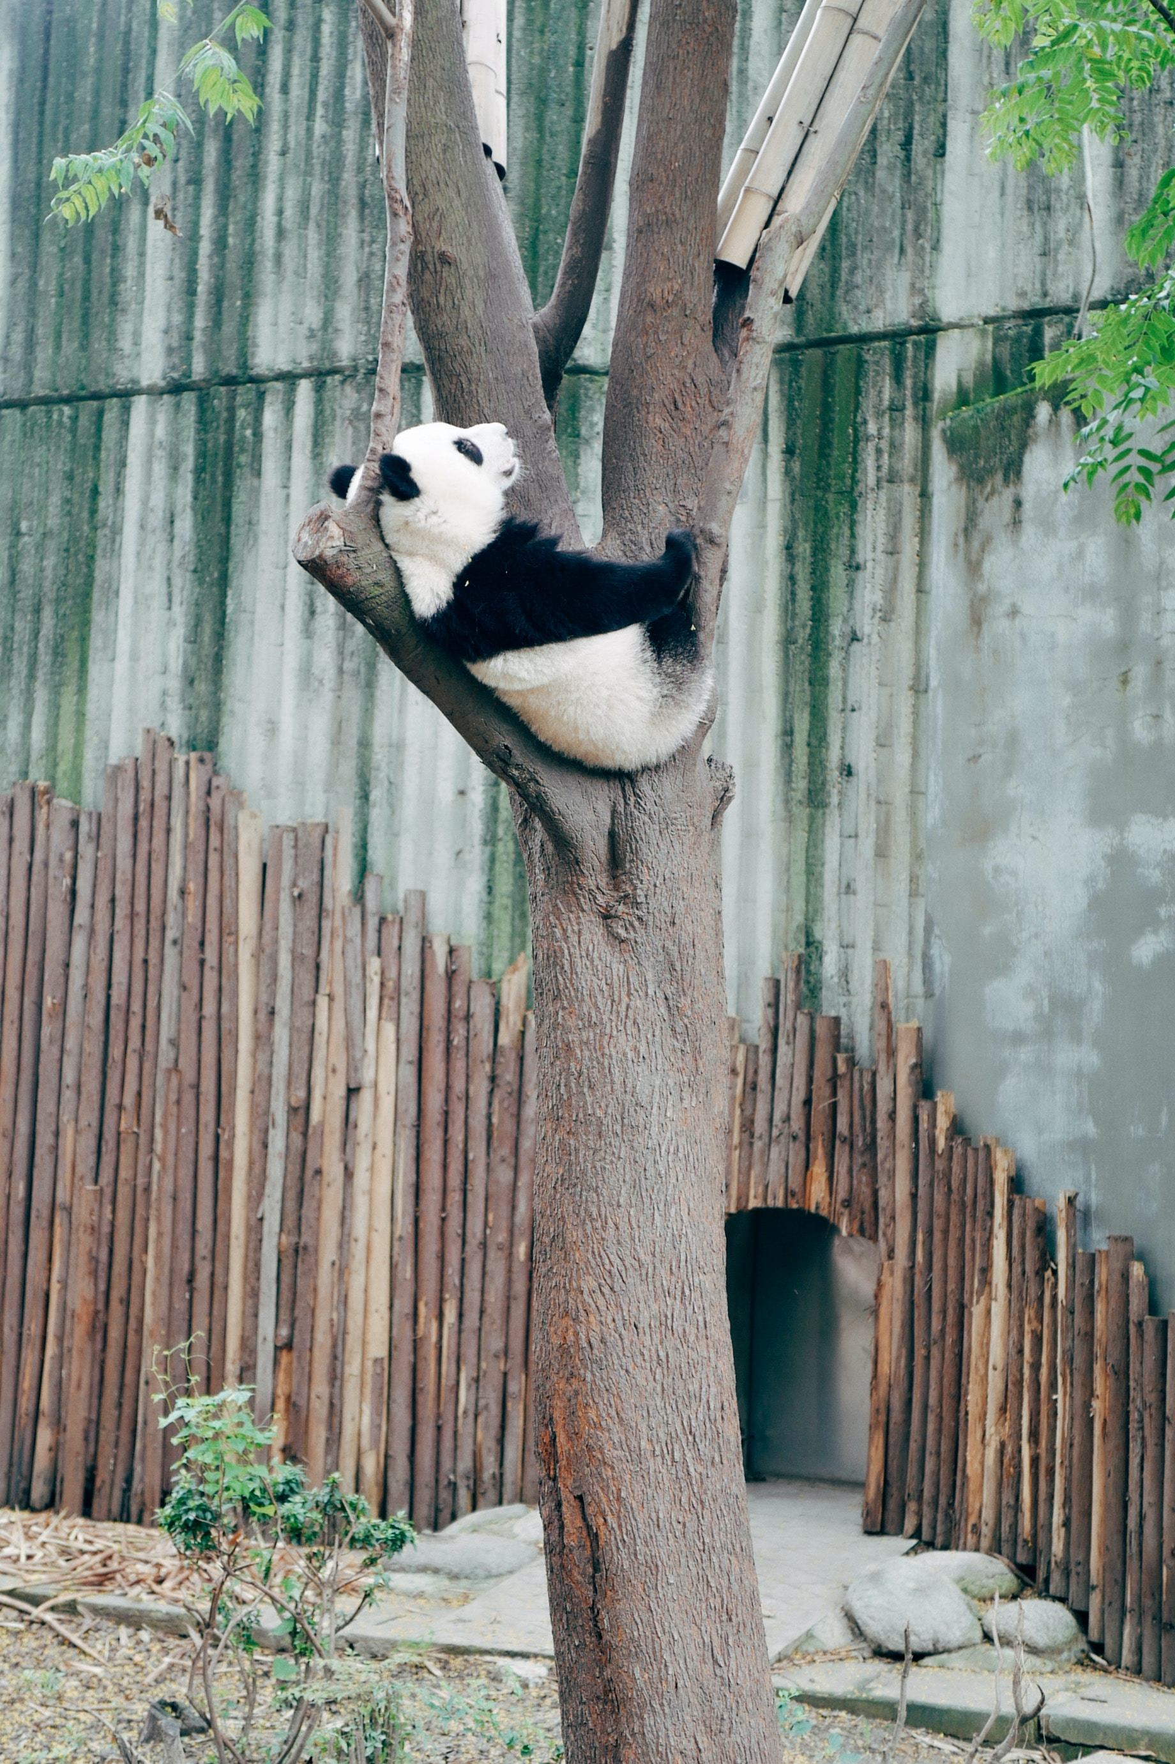
Photo by billow926 on Unsplash

Slide 5
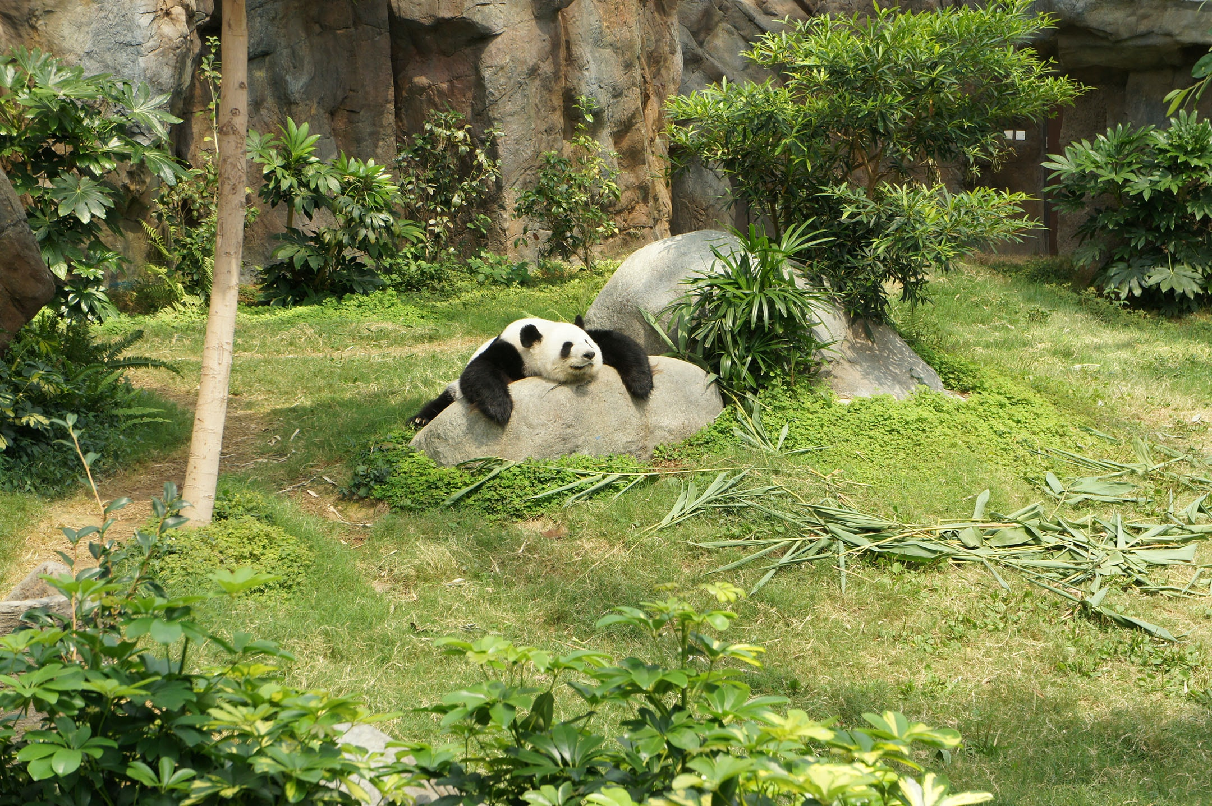
Photo by Elena Loshina on Unsplash

Slide 6

Photo by Debbie Molle on Unsplash

Slide 7

Solution
Buzz And Woody Meme on imgflip

Slide 8
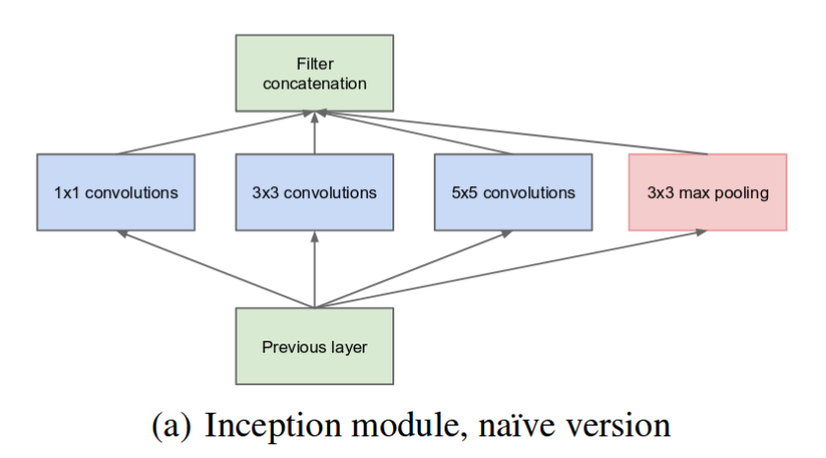
INCEPTION MODULE
the inception module enables the network to extract a richer set of features
C. Szegedy et al., "Going deeper with convolutions," 2015 IEEE Conference on Computer Vision and Pattern Recognition (CVPR), Boston, MA, USA, 2015, pp. 1-9, doi: 10.1109/CVPR.2015.7298594.

Slide 9
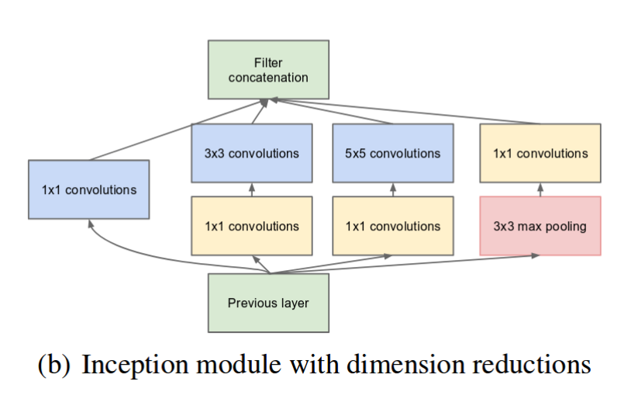
The addition of 1x1 convolutional layer within the inception module helps reduce the number of parameters and computational cost.
C. Szegedy et al., "Going deeper with convolutions," 2015 IEEE Conference on Computer Vision and Pattern Recognition (CVPR), Boston, MA, USA, 2015, pp. 1-9, doi: 10.1109/CVPR.2015.7298594.

Slide 10
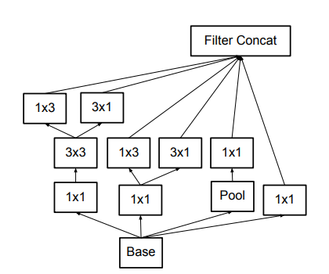
C. Szegedy, V. Vanhoucke, S. Ioffe, J. Shlens and Z. Wojna, "Rethinking the Inception Architecture for Computer Vision," 2016 IEEE Conference on Computer Vision and Pattern Recognition (CVPR), Las Vegas, NV, USA, 2016, pp. 2818-2826, doi: 10.1109/CVPR.2016.308.

Slide 11
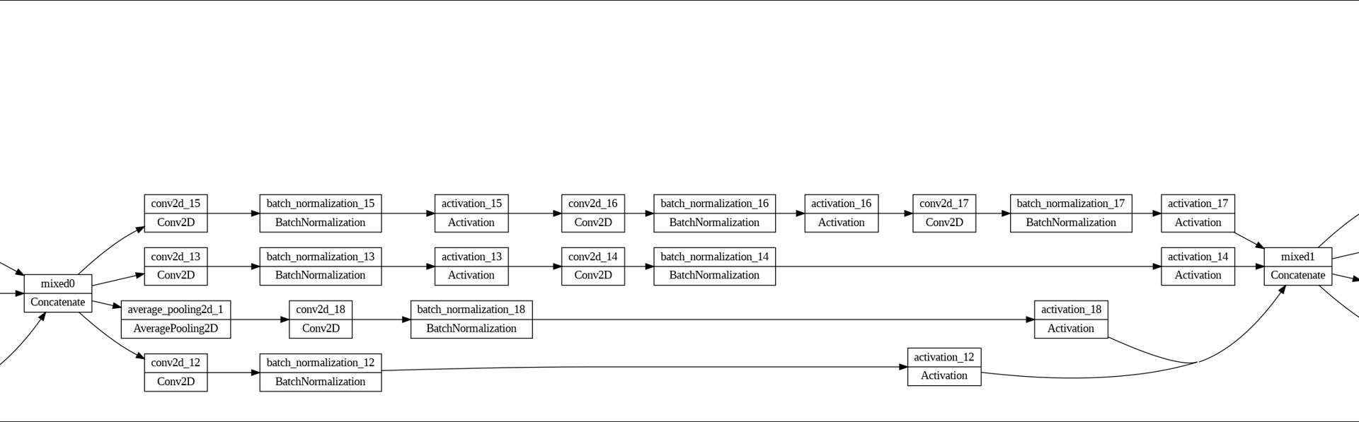

Slide 12
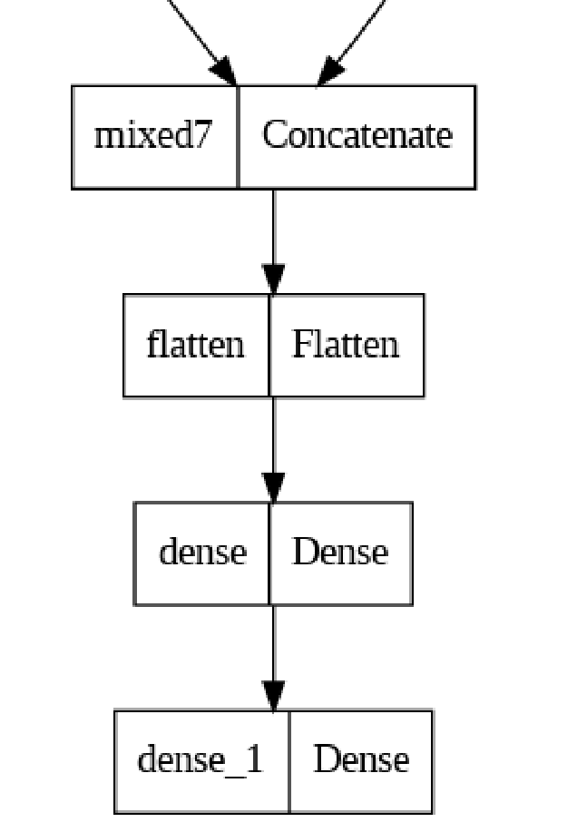
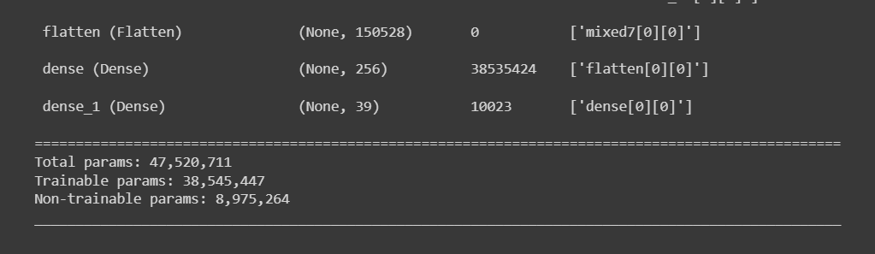

Slide 13
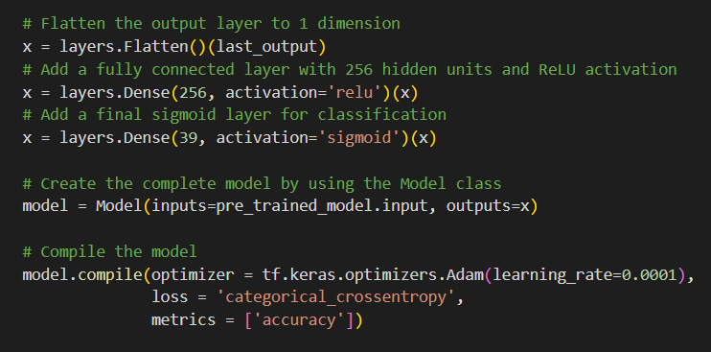

Slide 14
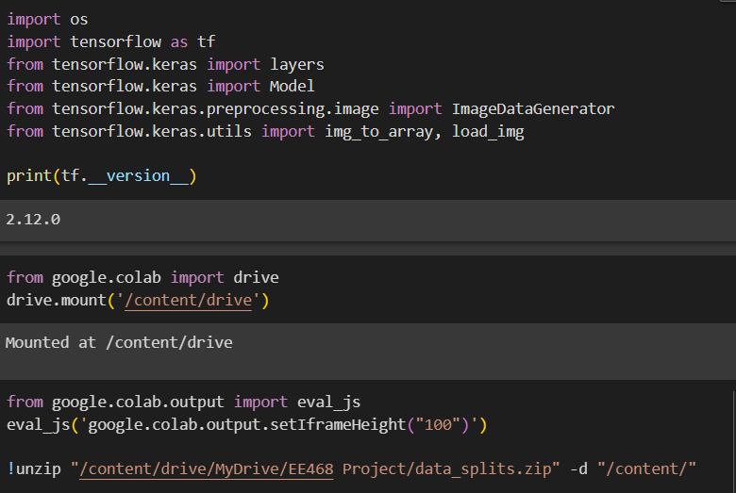

Slide 15
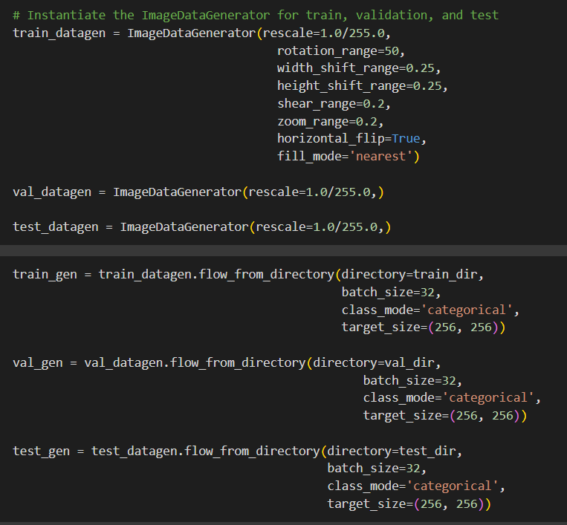

Slide 16
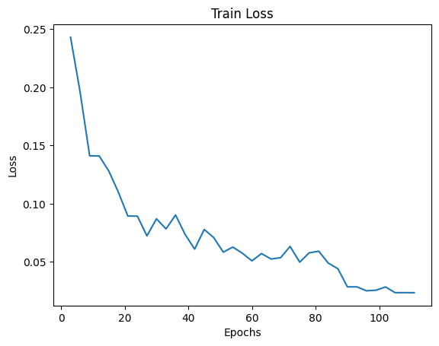

Slide 17
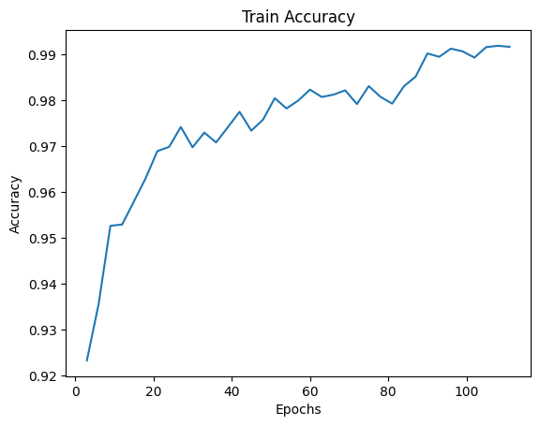

Slide 18
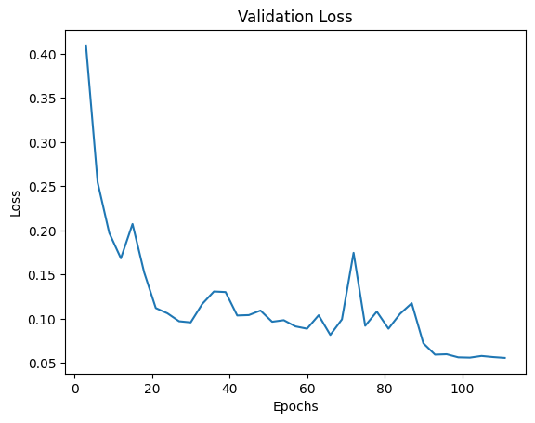

Slide 19
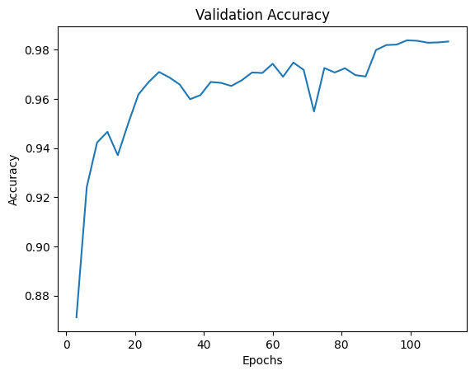

Slide 20
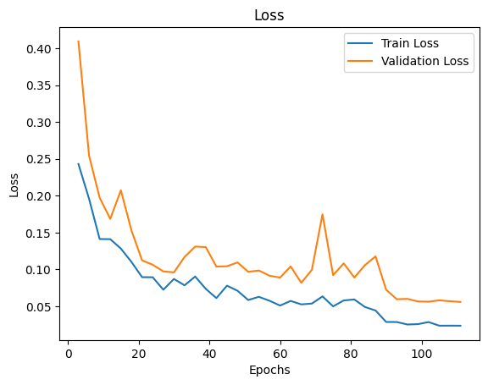

Slide 21
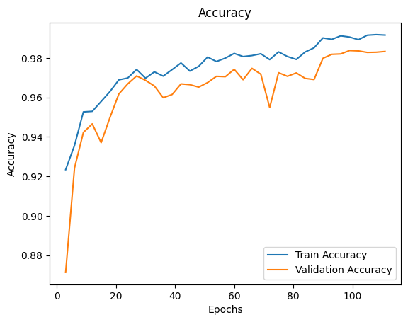

Slide 22
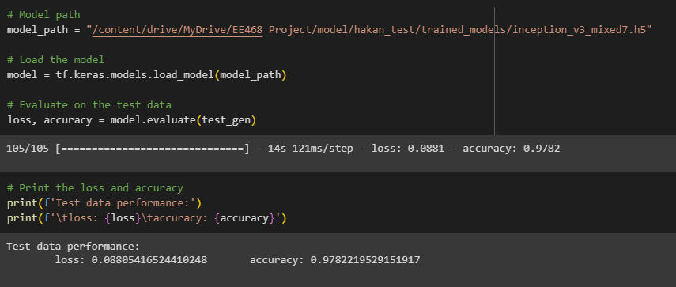

Slide 23
1- Photo by Riski Andriansyah on Unsplash
2- Image by Picsart AI Image generator on Picsart
3- C. Szegedy et al., "Going deeper with convolutions," 2015 IEEE Conference on Computer Vision and Pattern Recognition (CVPR), Boston, MA, USA, 2015, pp. 1-9, doi: 10.1109/CVPR.2015.7298594.
4- C. Szegedy, V. Vanhoucke, S. Ioffe, J. Shlens and Z. Wojna, "Rethinking the Inception Architecture for Computer Vision," 2016 IEEE Conference on Computer Vision and Pattern Recognition (CVPR), Las Vegas, NV, USA, 2016, pp. 2818-2826, doi: 10.1109/CVPR.2016.308.

